Slide 1
Welcome

Slide 2
NAN MUDHALVAN PROJECT

Slide 3
Title:
Plugging into feature: An Exploration of Electricity Consumption Patterns

Slide 4
Team Head : T. Kangalaskshmi Team Members: P. Kanagavel Natchiyar P. Karthikai selvi A. Kavitha
We are team of 4 students from III B.sc Mathamatics.
A.K.D. Dharmaraja Women’s Collage,
Rajapalayam.

Slide 5
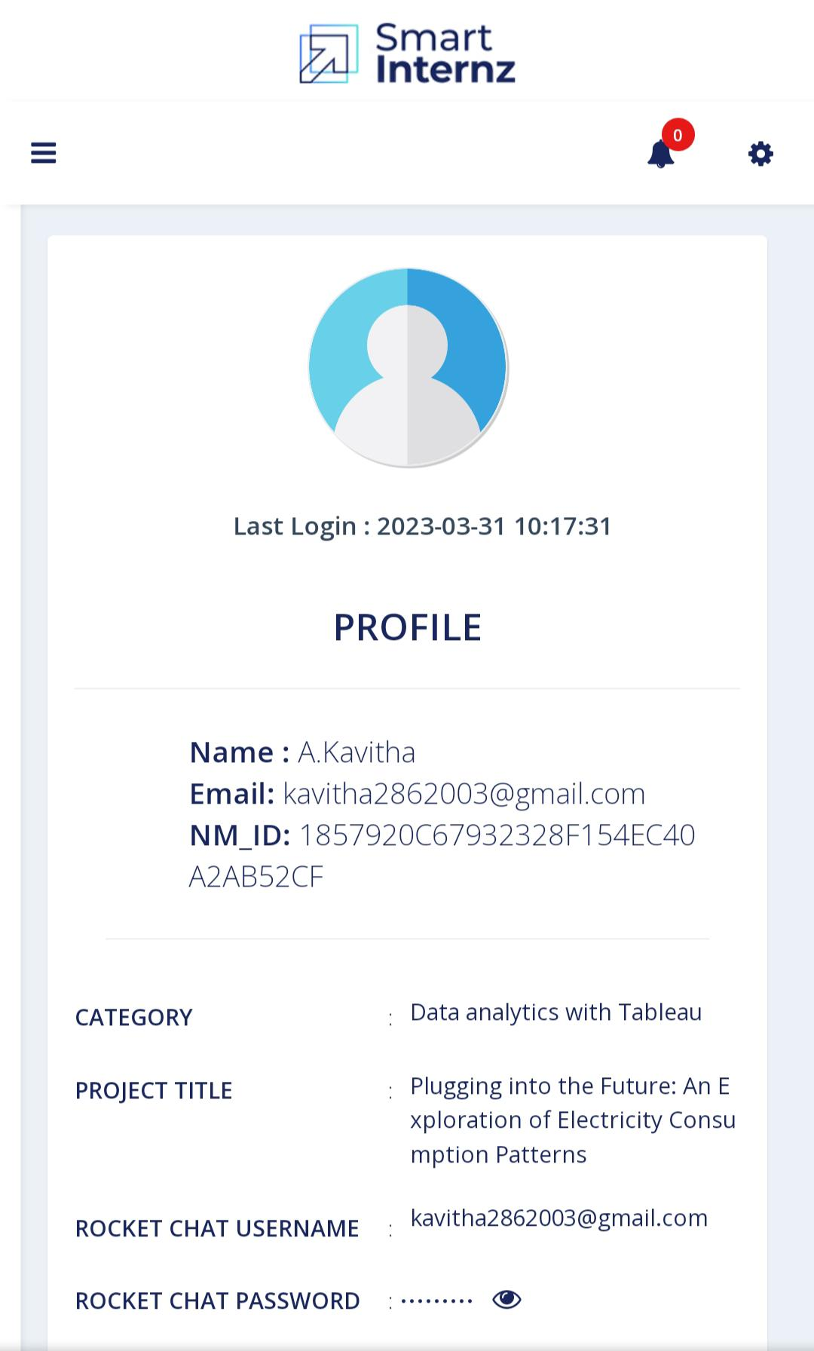
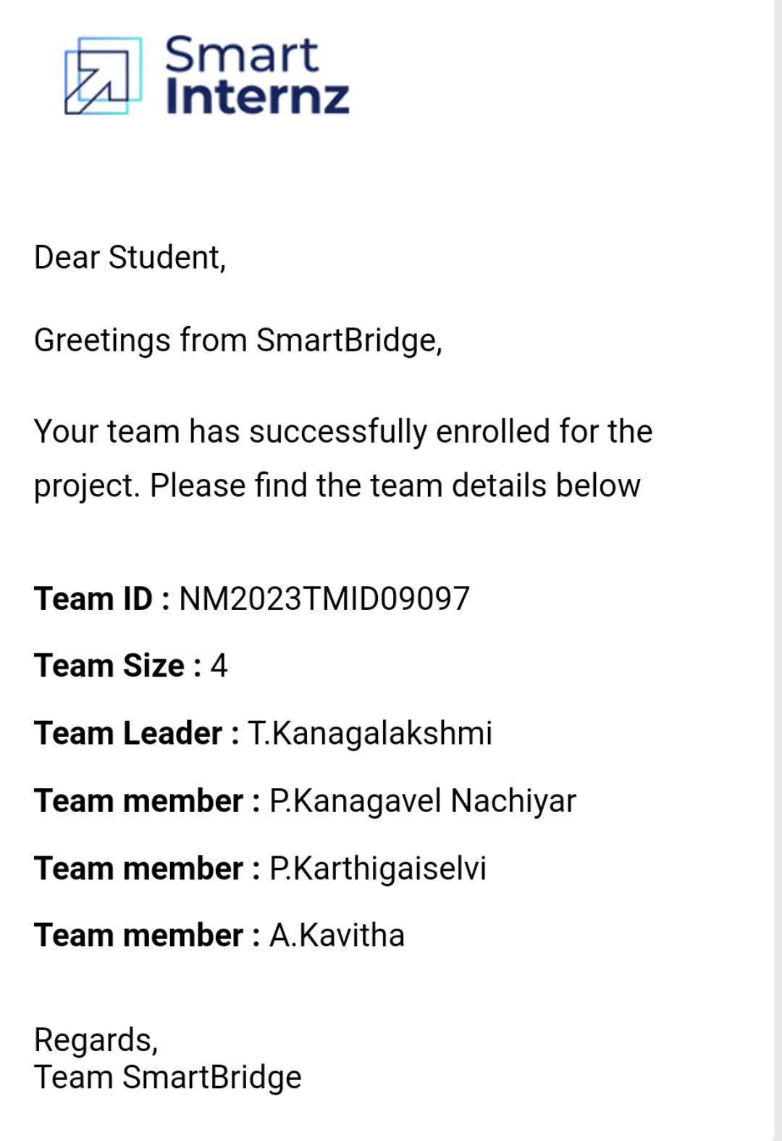
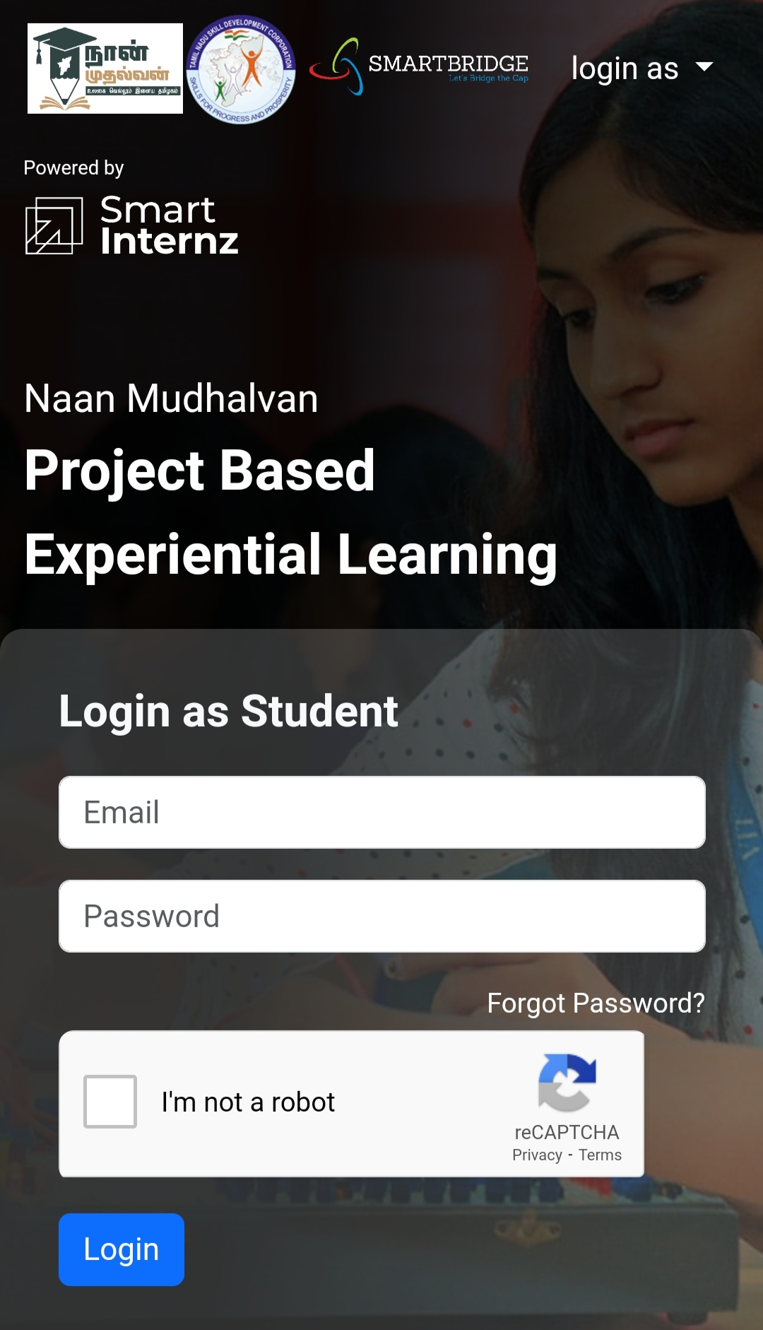
LOGIN IN NANMUDHALVAN

Slide 6
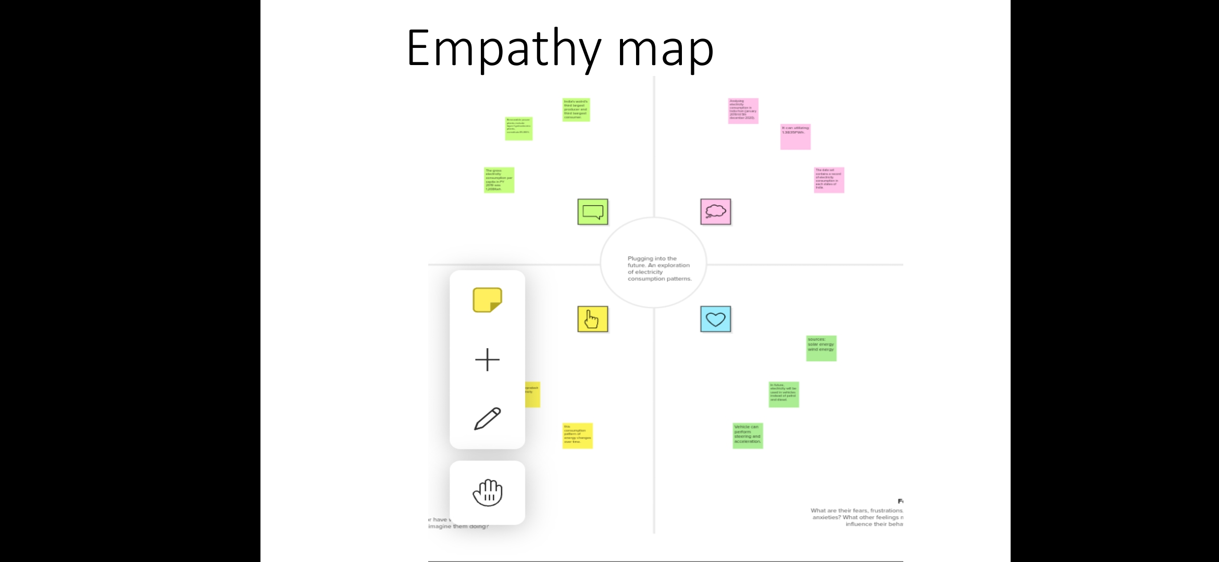
Empathy Map

Slide 7

BRAINSTORM

Slide 8
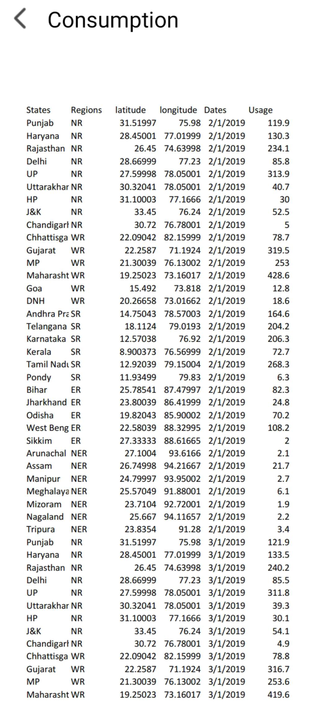
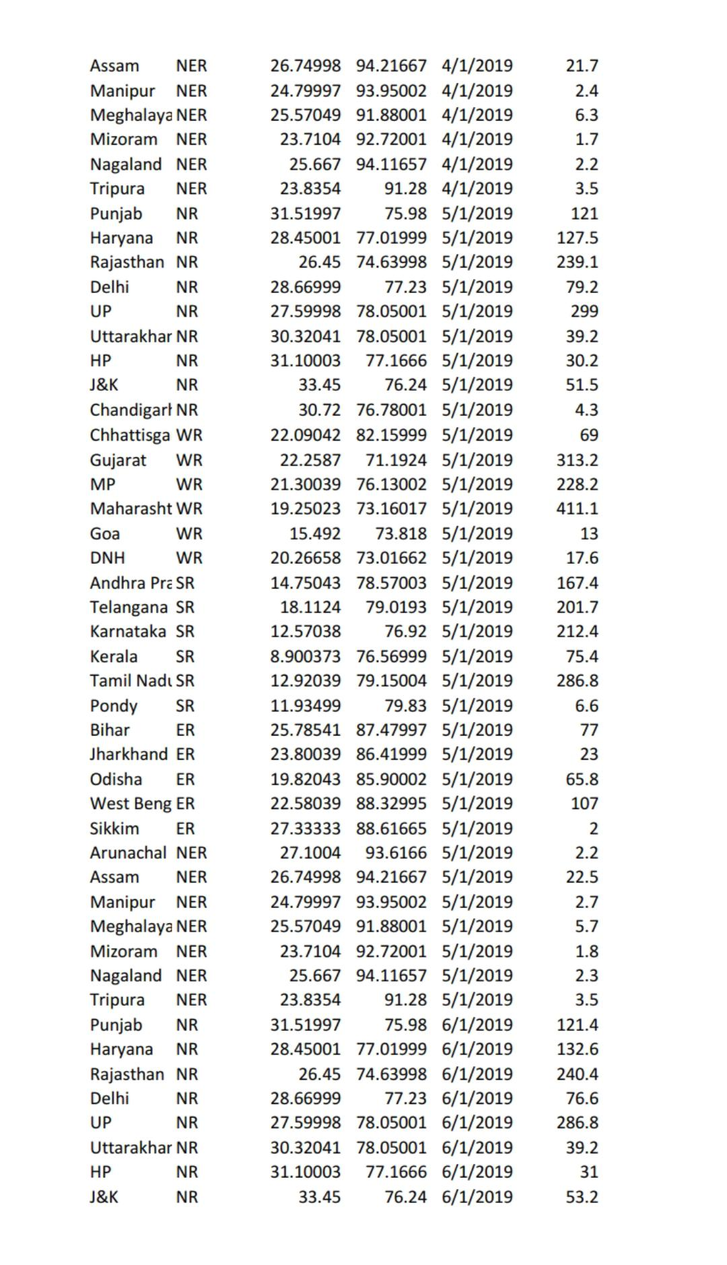
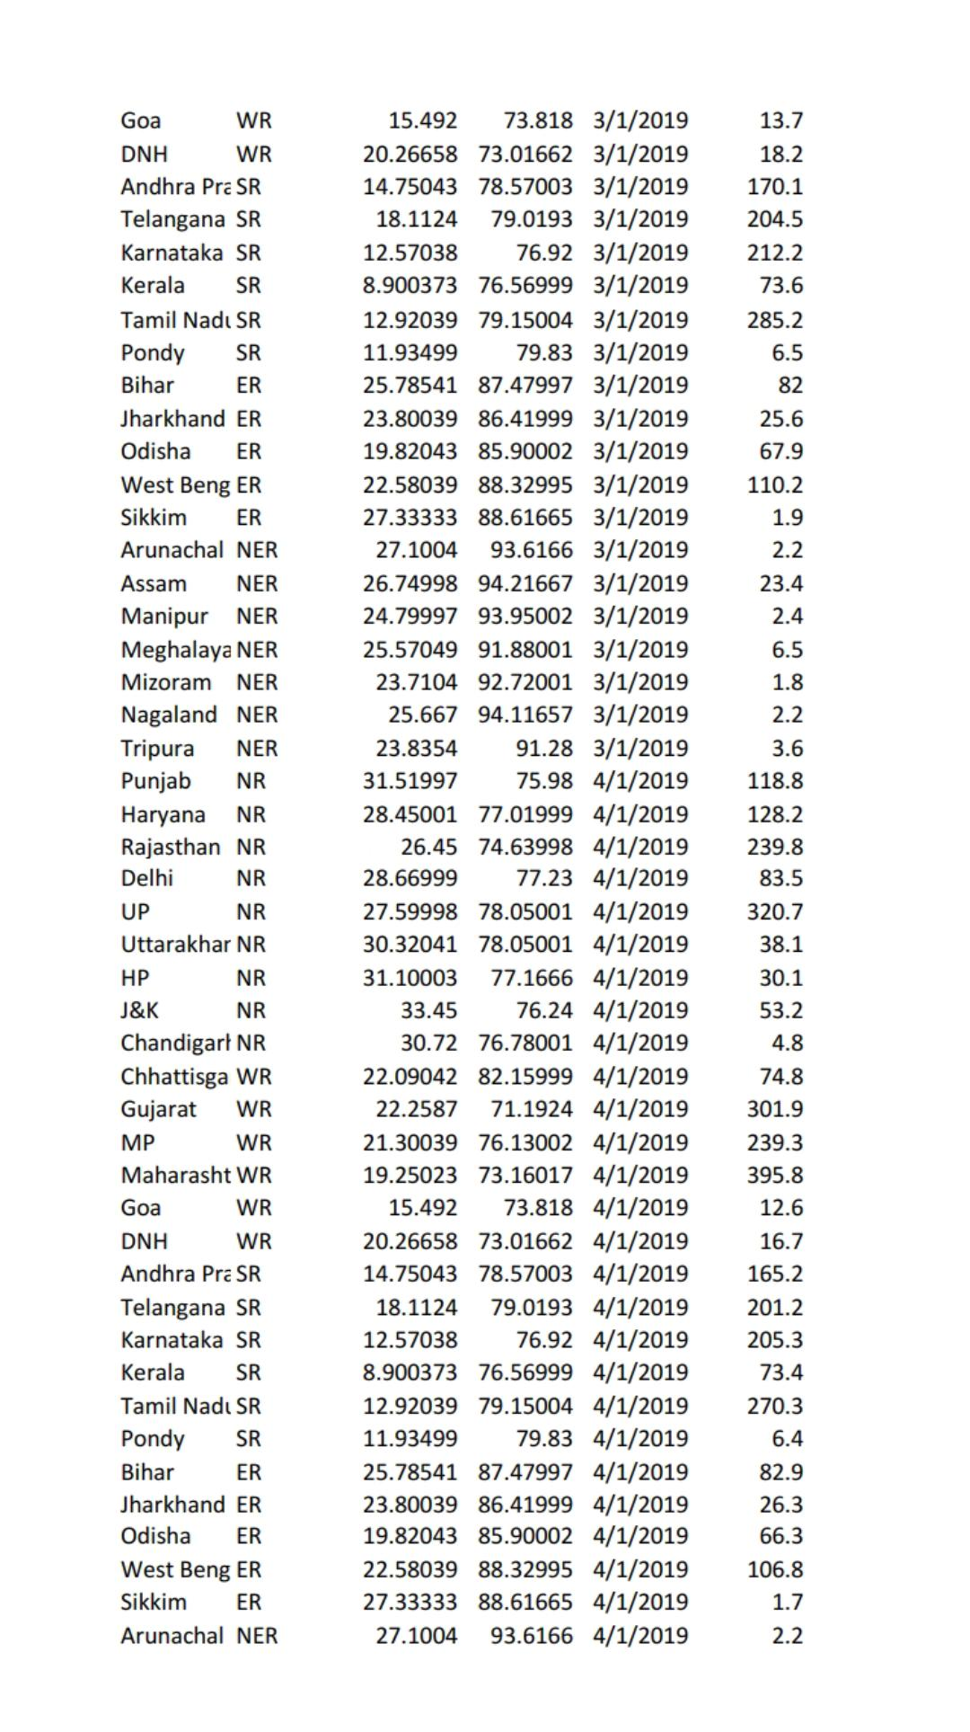
Data Sheet

Slide 9
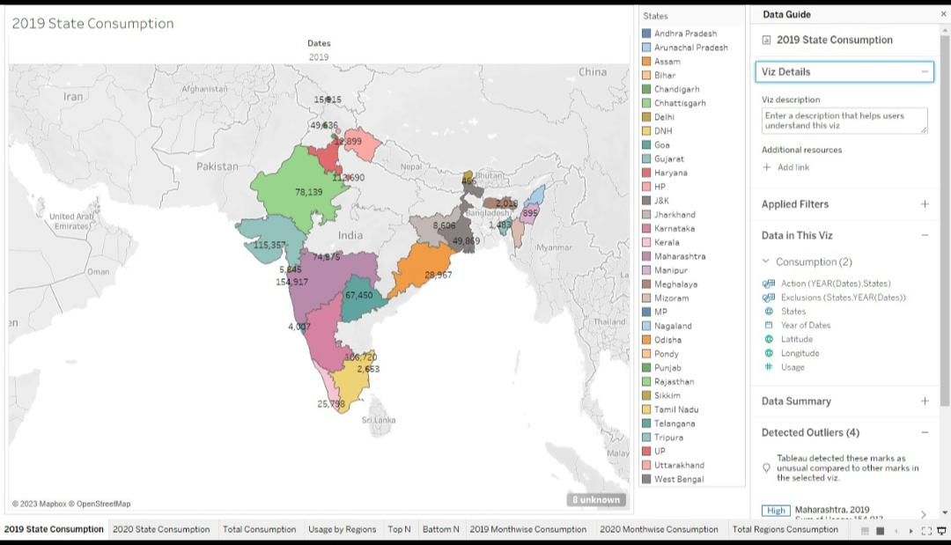
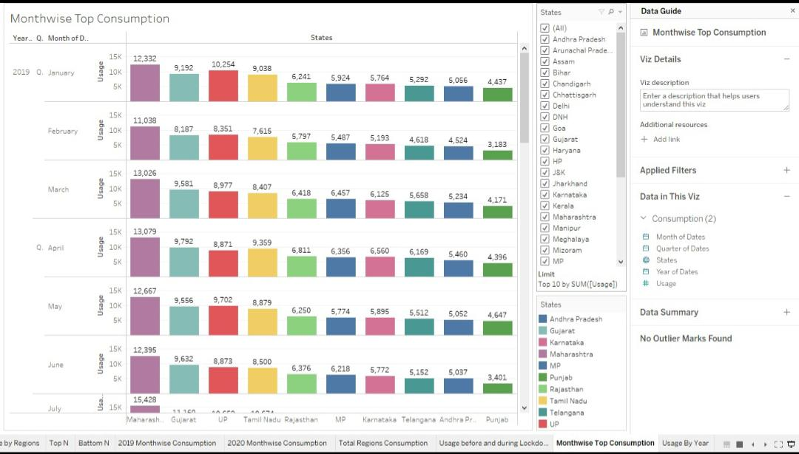
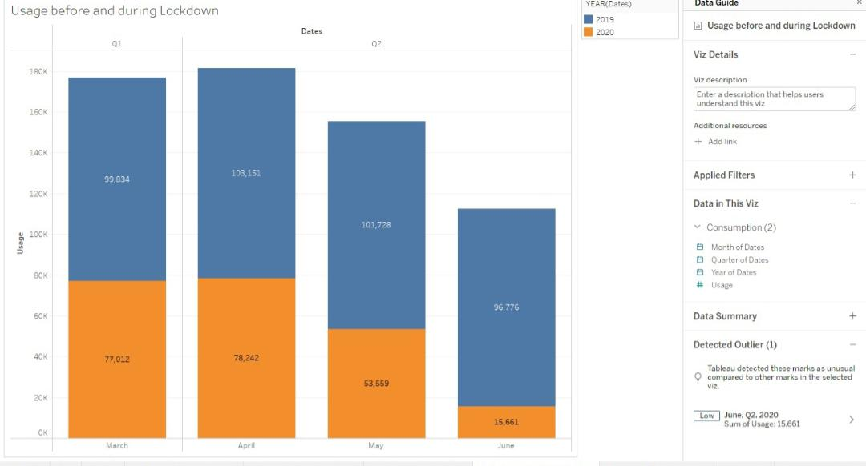
Tableau Sheet

Slide 10
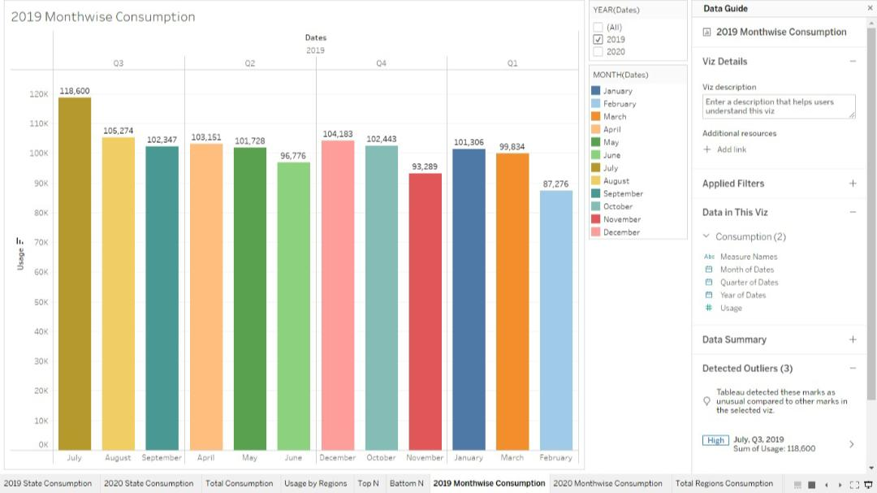
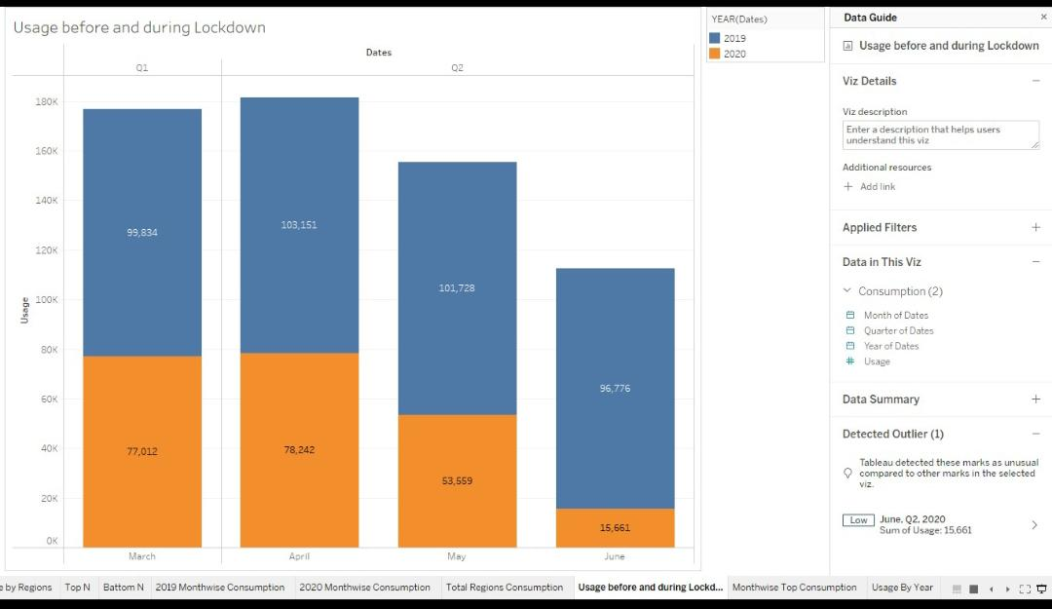
Month wise Consumption

Slide 11
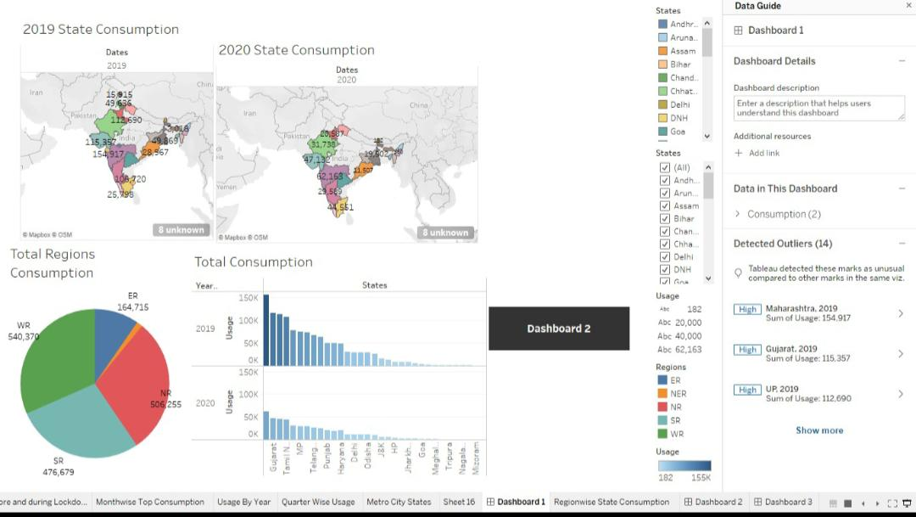
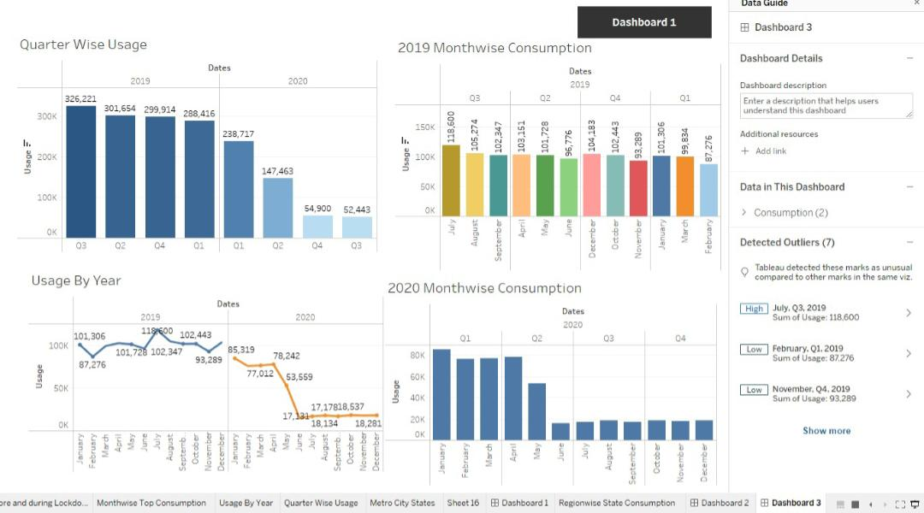
Dashboard

Slide 12
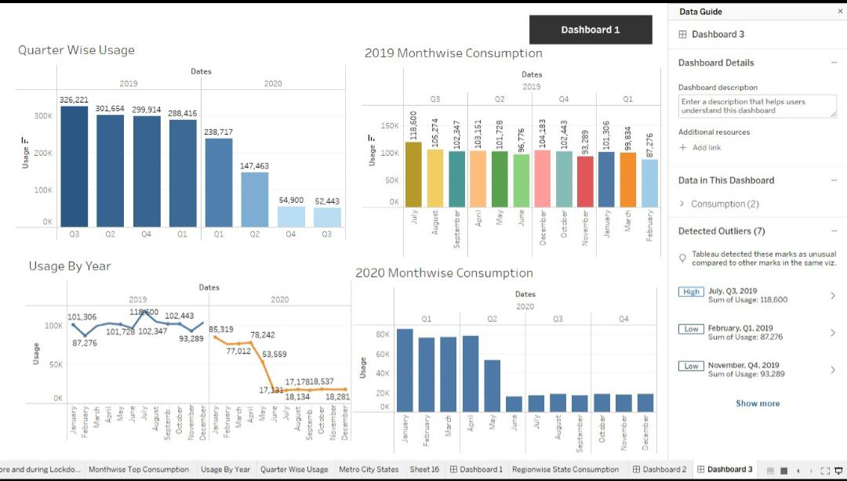
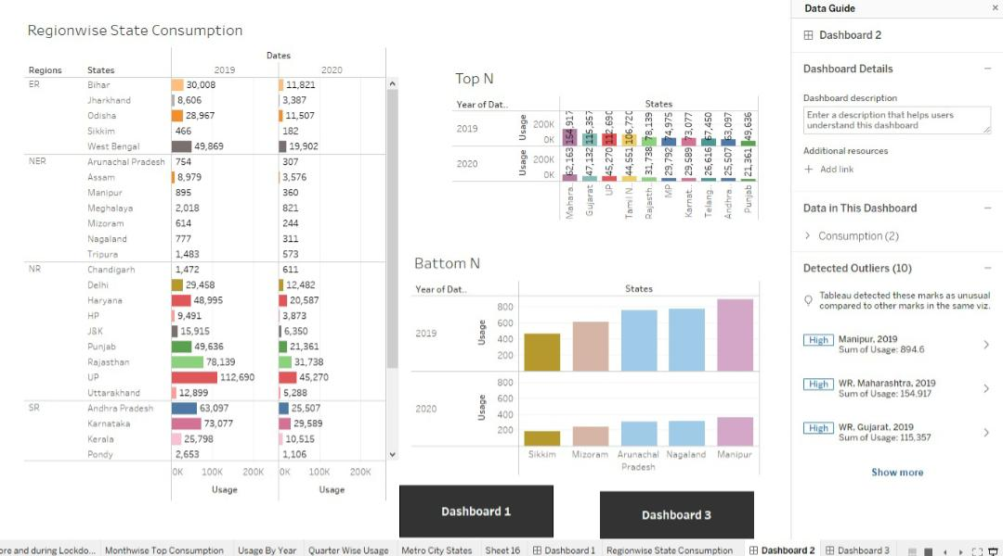

Slide 13
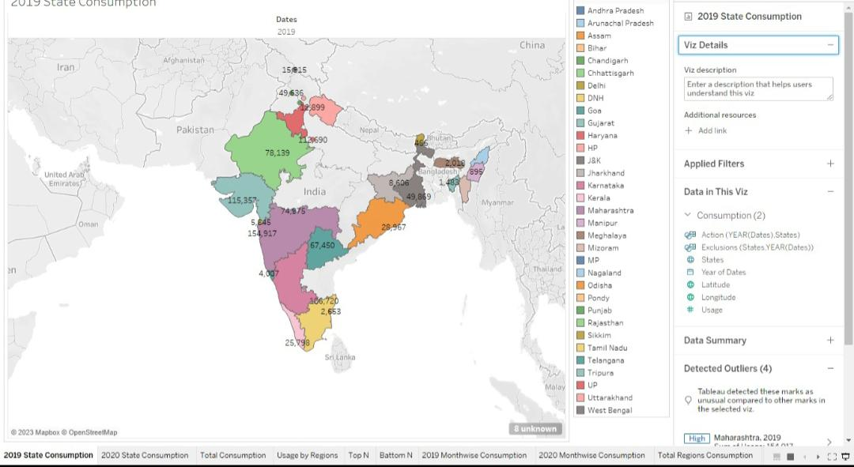
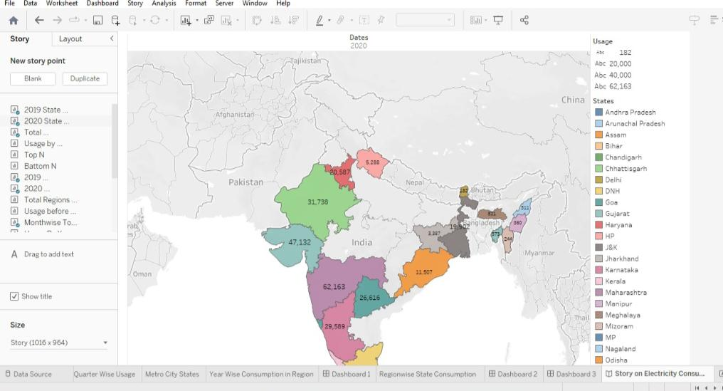
STORY

Slide 14
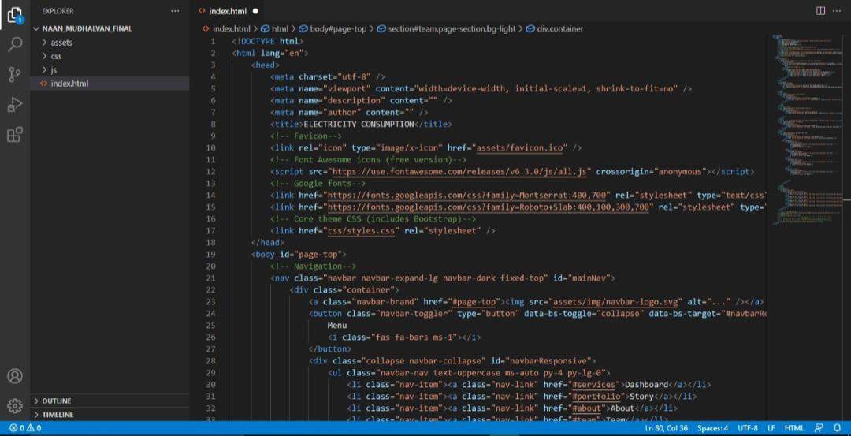
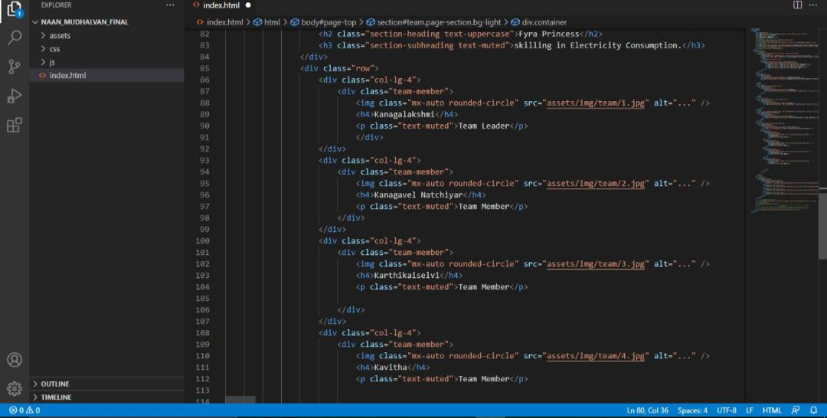
Python Coding

Slide 15
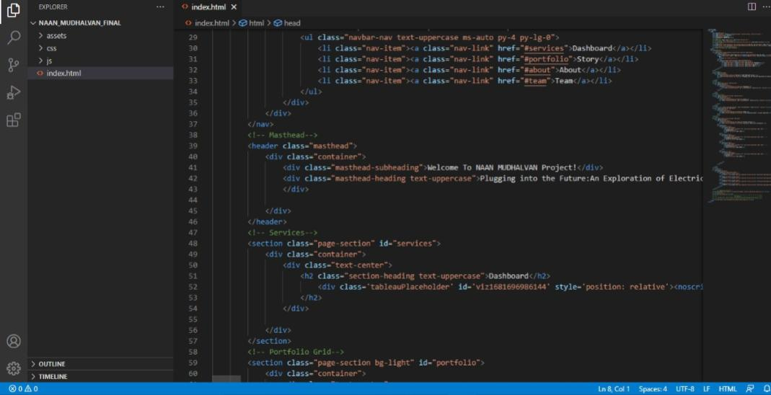
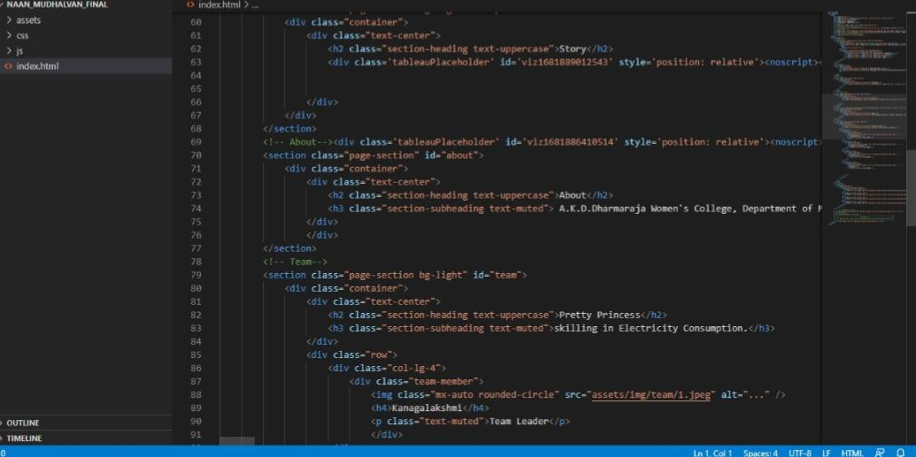

Slide 16
Thank YOU

